Slide 1
BOOSTING ALGORITHM
NANDHINI SHANMUGAVEL
Notes:
This template can be used as a starter file for presenting training materials in a group setting.
Sections
Right-click on a slide to add sections. Sections can help to organize your slides or facilitate collaboration between multiple authors.
Notes
Use the Notes section for delivery notes or to provide additional details for the audience. View these notes in Presentation View during your presentation.
Keep in mind the font size (important for accessibility, visibility, videotaping, and online production)
Coordinated colors
Pay particular attention to the graphs, charts, and text boxes.
Consider that attendees will print in black and white or grayscale. Run a test print to make sure your colors work when printed in pure black and white and grayscale.
Graphics, tables, and graphs
Keep it simple: If possible, use consistent, non-distracting styles and colors.
Label all graphs and tables.

Slide 2
BOOSTING ALOGORITHMS IN MACHINE LEARNING
Boosting is a method used in machine learning to reduce errors in predictive data analysis.
Data scientists train machine learning software, called machine learning models, on labeled data to make guesses about unlabeled data.
A single machine learning model might make prediction errors depending on the accuracy of the training dataset.
For example, if a cat-identifying model has been trained only on images of white cats, it may occasionally misidentify a black cat.
Boosting tries to overcome this issue by training multiple models sequentially to improve the accuracy of the overall system.
Notes:
Give a brief overview of the presentation. Describe the major focus of the presentation and why it is important.
Introduce each of the major topics.
To provide a road map for the audience, you can repeat this Overview slide throughout the presentation, highlighting the particular topic you will discuss next.

Slide 3
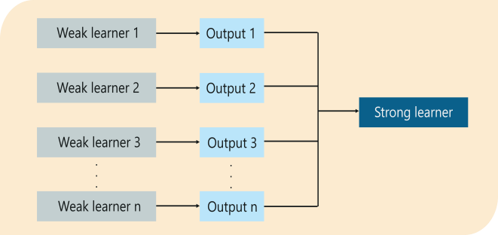
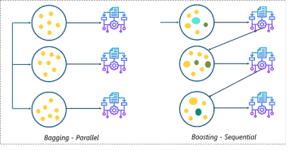
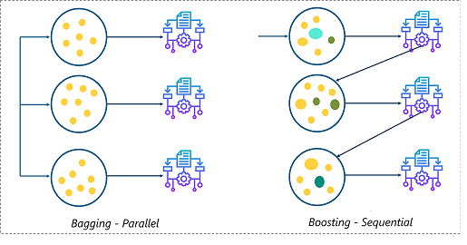
Notes:
This is another option for an Overview slides using transitions.

Slide 4
BOOSTING ALOGORITHM REGRESSION
Ada Boosting (Adaptive Boosting)
Gradient Boosting
Hist Gradient Boosting

Slide 5
Adaboost regressor
An AdaBoost [1] regressor is a meta-estimator that begins by fitting a regressor on the original dataset and then fits additional copies of the regressor on the same dataset but where the weights of instances are adjusted according to the error of the current prediction.
As such, subsequent regressors focus more on difficult cases.
This class implements the algorithm known as AdaBoost.

Slide 6
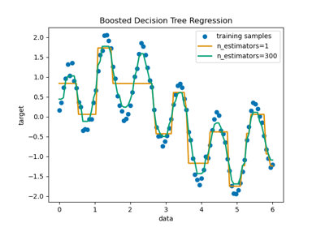
Example of AdaboostRegressor
This blog serves as a comprehensive guide on the AdaBoost algorithm, a powerful technique in machine learning. Unravel the intricacies of AdaBoost machine learning algorithm, exploring its applications across industries, understanding its inner workings, and delve into practical adaboost project ideas to implement this algorithm effectively in Python.

Slide 7

GradientBoostingRegressor
Gradient Boosting for regression.
This estimator builds an additive model in a forward stage-wise fashion; it allows for the optimization of arbitrary differentiable loss functions.
In each stage a regression tree is fit on the negative gradient of the given loss function.
Missing values and categorical data are natively supported by the Hist… version, removing the need for additional preprocessing such as imputation.

Slide 8
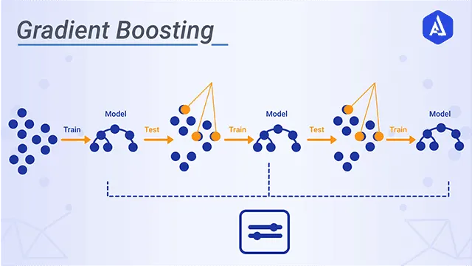
The idea of gradient boosting is to improve weak learners and create a final combined prediction model. Decision trees are mainly used as base learners in this algorithm.
Notes:
This is another option for an Overview slide.

Slide 9
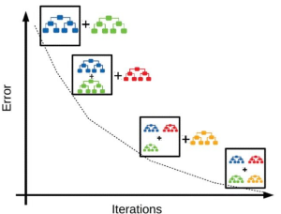
Gradient Boosting Machines (GBM) Algorithm is considered as one of the most powerful ensemble machine learning algorithms used for both regression and classification problems. This algorithm has been proven to increase the accuracy of predictions and is found to be extremely popular among data scientists. Let’s take a closer look at GBM and explore how it works with an example.
Notes:
What will the audience be able to do after this training is complete? Briefly describe each objective how the audience will benefit from this presentation.

Slide 10
HistGradientBoosting Regressor
Notes:
Use a section header for each of the topics, so there is a clear transition to the audience.

Slide 11
HistGradientBoosting Regressor
This estimator has native support for missing values (NaNs).
During training, the tree grower learns at each split point whether samples with missing values should go to the left or right child, based on the potential gain.
When predicting, samples with missing values are assigned to the left or right child consequently.
If no missing values were encountered for a given feature during training, then samples with missing values are mapped to whichever child has the most samples.
Notes:
Add slides to each topic section as necessary, including slides with tables, graphs, and images.
See next section for sample table, graph, image, and video layouts.

Slide 12
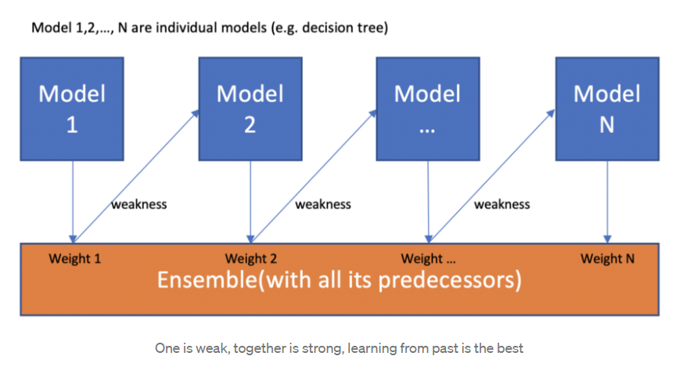
HistGradientBoosting Regressor
Notes:
Keep it brief. Make your text as brief as possible to maintain a larger font size.

Slide 13
Advantages of Histogram-Based Gradient Boosting Speed One of the primary advantages of histogram-based gradient boosting is its remarkable speed. Traditional methods can become slow when dealing with a large number of samples, but histogram-based estimators can be orders of magnitude faster in such scenarios. This speed boost is mainly attributed to the use of histograms and optimized data structures.
Built-In Support for Missing Values
Histogram-based estimators come with built-in support for handling missing values. This means you don’t need to preprocess your data by imputing missing values before training the model. The algorithm learns how to handle missing data during training, making the process more straightforward and efficient.

Slide 14
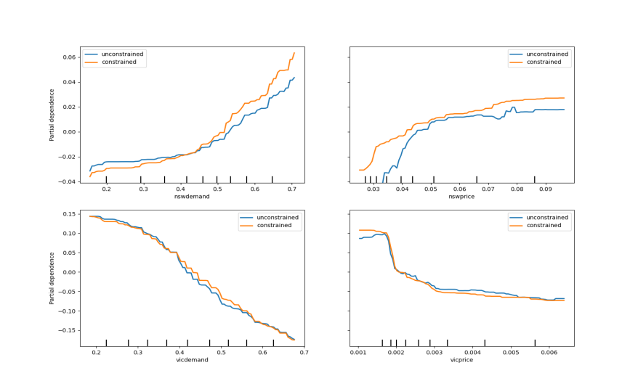
example
Notes:
If there is relevant video content, such as a case study video, demo of a product, or other training materials, include it in the presentation as well.

